Slide 1

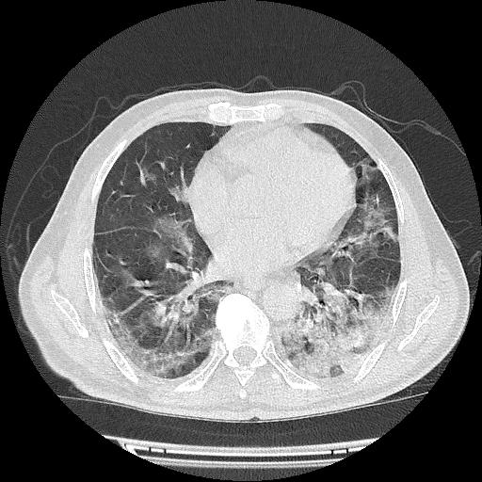
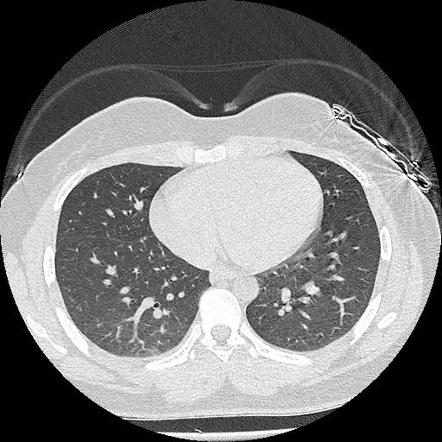
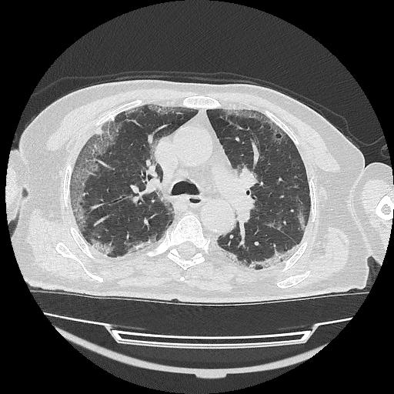
IMAGE PROCESSING PROJECT
COBBLESTONES
BUDDING TREE
PATTERN MATCHING OF GROUND-GLASS OPACITIES
HALİME ÖZGE KABAK
180403001
START

Slide 2





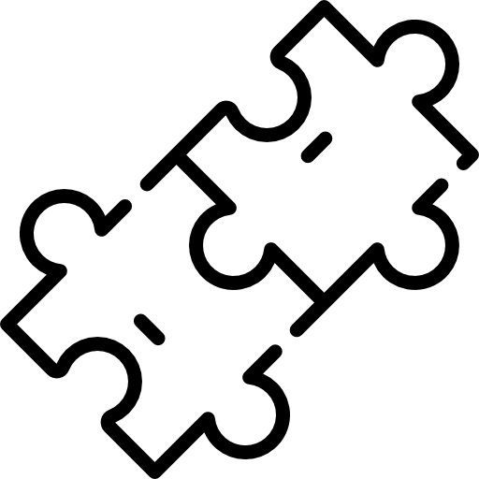

TABLE OF CONTENTS
DATA
PREPROCESSING
INTRODUCTION
01
02
03
04
RESULTS
TEMPLATE MATCHING

Slide 3
01.
INTRODUCTION
01
02
03
04

Slide 4
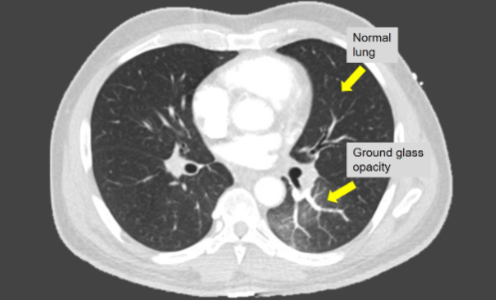
INTRODUCTION
WHAT IS GROUND-GLASS OPACITIES ?
.
GGO refers to gray areas that can show up in lung X-rays or computed tomography (CT) scans. Normally, the lungs appear black in X-ray and CT scans. This indicates that they are free of any visible blockages.
However, gray areas indicate increased density, meaning that something is partially filling the air spaces inside the lungs. GGO can be due to many conditions. Sometimes, the cause is benign. Other times, it may be the temporary result of a short-term illness.
01
02
03
04

Slide 5
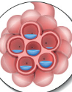
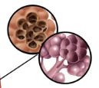
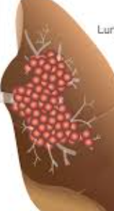
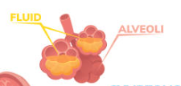
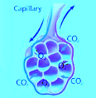
INTRODUCTION
CAUSES OF GGO
01
02
Pneumonitis
Pulmonary Edema
03
E-cigarette or Vaping E-cigarette or Vaping Use-Associated Lung Injury (EVALI)
04
Infections
Cancer

Slide 6
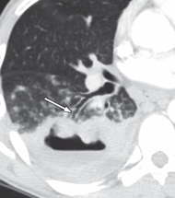
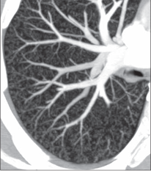
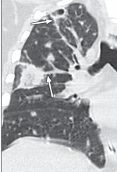
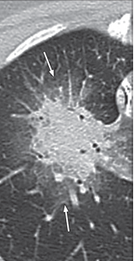
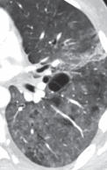
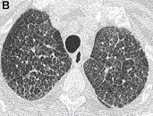
INTRODUCTION
TYPES OF PATTERNS
BUDDING TREE
AIR FLUID LEVEL
FEEDING VESSEL
01
HALO
02
03
CRAZY PAVING
04
COBBLESTONE

Slide 7
AIM OF THE PROJECT
INTRODUCTION
01
02
03
The aim of this project is to find out whether the infected areas in the lung CTs of patients infected with COVID-19 belong to the budding tree or cobblestones class by using image processing methods.
04

Slide 8
02.
DATA PREPROCESSING
01
02
03
04

Slide 9
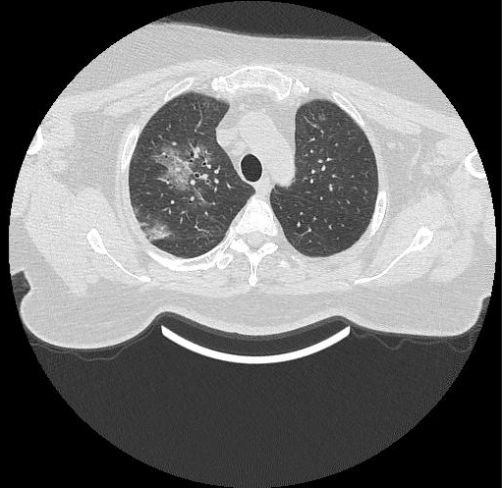
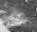
COBBLESTONES
BUDDING TREE
OTHERS
DATA PREPROCESSING
All images in the dataset were cropped so that patterns could be detected properly. In this way, only the part with the pattern remained in the images.
01
02
03
04

Slide 10
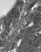
COBBLESTONES
BUDDING TREE
OTHERS
DATA PREPROCESSING
All images in the dataset were cropped so that patterns could be detected properly. In this way, only the part with the pattern remained in the images.
01
02
03
04

Slide 11
03.
TEMPLATE MATCHING
01
02
03
04

Slide 12
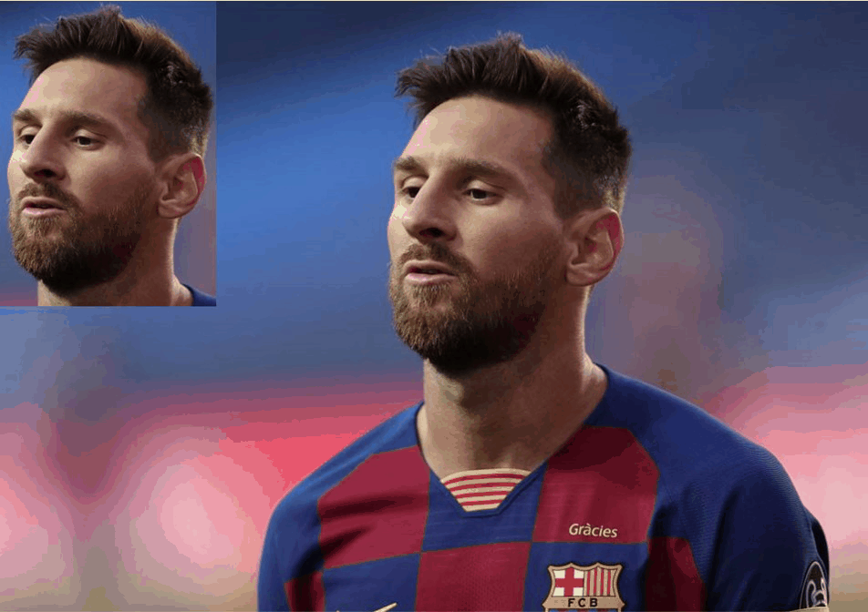
TEMPLATE MATCHING
What Is Template Matching?
01
Template matching is a technique in digital image processing for finding small parts of an image which match a template image. Template matching comprises of two main components: the source image and the template image or the patch. The source image is the picture in which we expect to find a match to the template image, while the template image is the patch image which will be compared to the sub-image of the source image.
02
03
04

Slide 13
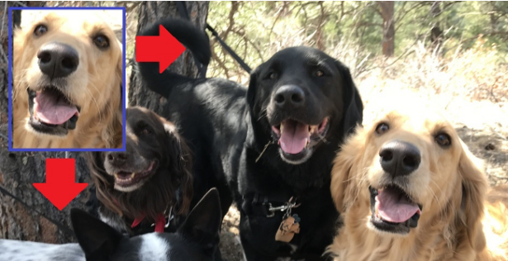
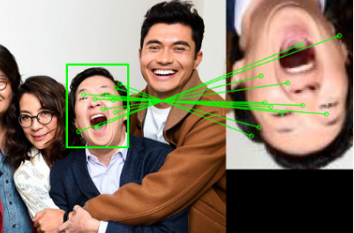
TEMPLATE MATCHING
The two general classifications of template or image matching are template-based and feature-based. The template-based approach, also known as the area-based approach, functions very well when templates have no strong features with an image since they operate directly on the pixel values. Matches are measured using the intensity values of both the image and the template. On the other hand, the feature-based approach is used when both source and template images contain more correspondence with respect to features and control points. In this case, features include points, curves, or a surface model to perform template matching.
01
02
Template Based
Template Based
Feature Based
03
04

Slide 14
TEMPLATE MATCHING
The template matching method was used to determine the type of GGOs found in the lung. The steps used for this are listed below.
01
02
01
02
03
03
TEMPLATE SELECTION
TEMPLATE COLOUR MAP EXAMINATION
GRAPHICAL USER INTERFACE
04

Slide 15
04.
RESULTS
01
02
03
04

Slide 16
TEMPLATE SELECTION RESULTS
RESULTS
01
 | IMAGE 120 | IMAGE 121 | IMAGE 122 | IMAGE 123 | IMAGE 124
IMAGE 1 | 0,9641190857 | 0,9380845805 | 0,9176853505 | 0,9556235978 | 0,8894541349
IMAGE 5 | 0,9509354799 | 0,9323382297 | 0,9145793368 | 0,9548718811 | 0,8924661995
IMAGE 10 | 0,9564404615 | 0,9381552384 | 0,9256536765 | 0,9599588541 | 0,8678306521
IMAGE 25 | 0,8944517706 | 0,9182311192 | 0,8903468401 | 0,918015884 | 0,8818059287
IMAGE 35 | 0,9450338603 | 0,9348675498 | 0,9120178071 | 0,9469823836 | 0,9001774384
In this step, first of all, it was necessary to find the best templates for the images to be detected properly. For this purpose, each of the cropped cobblestone images were template matching with each other, and then the highest similarity ratio was calculated and saved in an excel file and analyzed. Pictures with the highest similarity ratio were selected as templates. The same operations were performed for the budding tree and templates were selected.
02
03
04

Slide 17
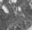
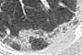
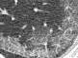
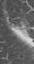

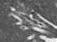
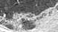
A total of 16 templates were selected according to the obtained values. Equal amounts of templates were selected from both classes so that they affect the picture equally.
RESULTS
A total of 16 templates were selected according to the obtained values. Equal amounts of templates were selected from both classes so that they affect the picture equally.
01
02
03
04

Slide 18
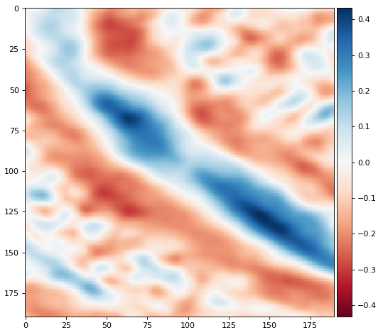
RESULTS
TEMPLATE COLOUR MAP
01
02
By using the template color map, it is determined which parts are match. These values vary between 1 and -1. Closer to -1, similarity decreases, but closer to 1, similarity increases. The places where the similarity is high are shown in blue and the places where the similarity is low are shown in red.
03
04

Slide 19
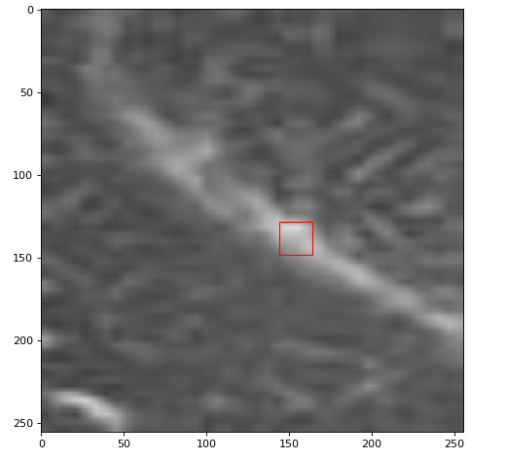
RESULTS
TEMPLATE COLOUR MAP
01
The part showing the maximum similarity according to this map is shown in the original picture by framing it.
02
03
04

Slide 20
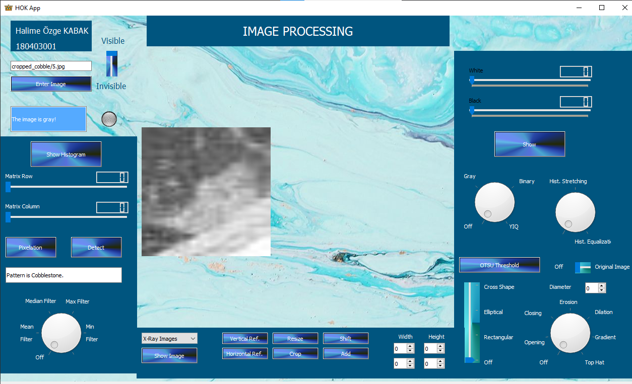
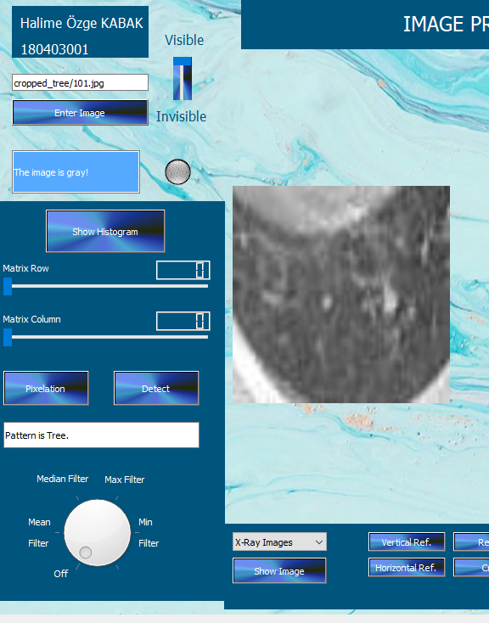
Finally, the algorithm was integrated into the interface according to the data obtained. Accordingly, when the "detect" button is clicked after the image is entered, it shows whether the pattern is cobblestone or tree.
RESULTS
01
02
03
04

Slide 21

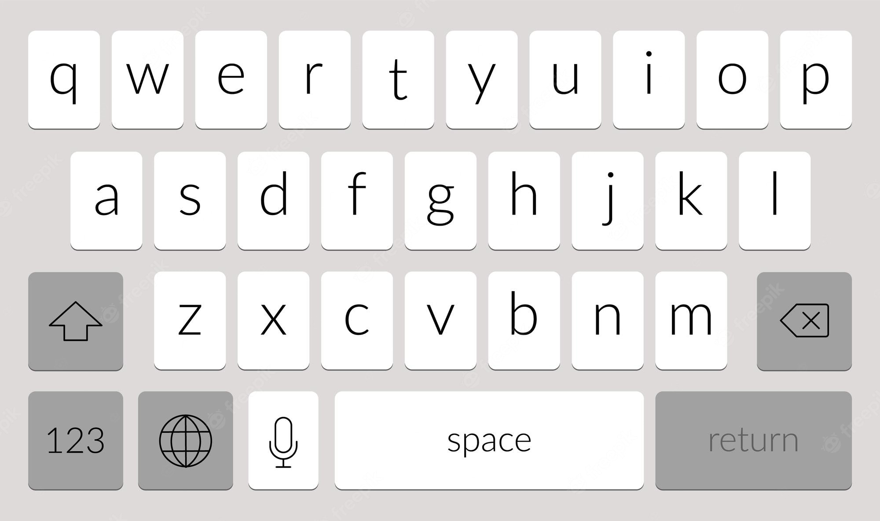
RESULTS
01
02
%86
An accuracy rate of 86 percent was obtained by making trials on a total of 334 images.
03
04

Slide 22

THANKS!
01
02
03
04

